Slide 1
ThrYve
December ‘19 –December ‘20
A YEAR TO REMEMBER
ThrYve

Slide 2
Holiday Parties Winter 2019
Northwest, Sumner, & Wyandotte

Slide 3
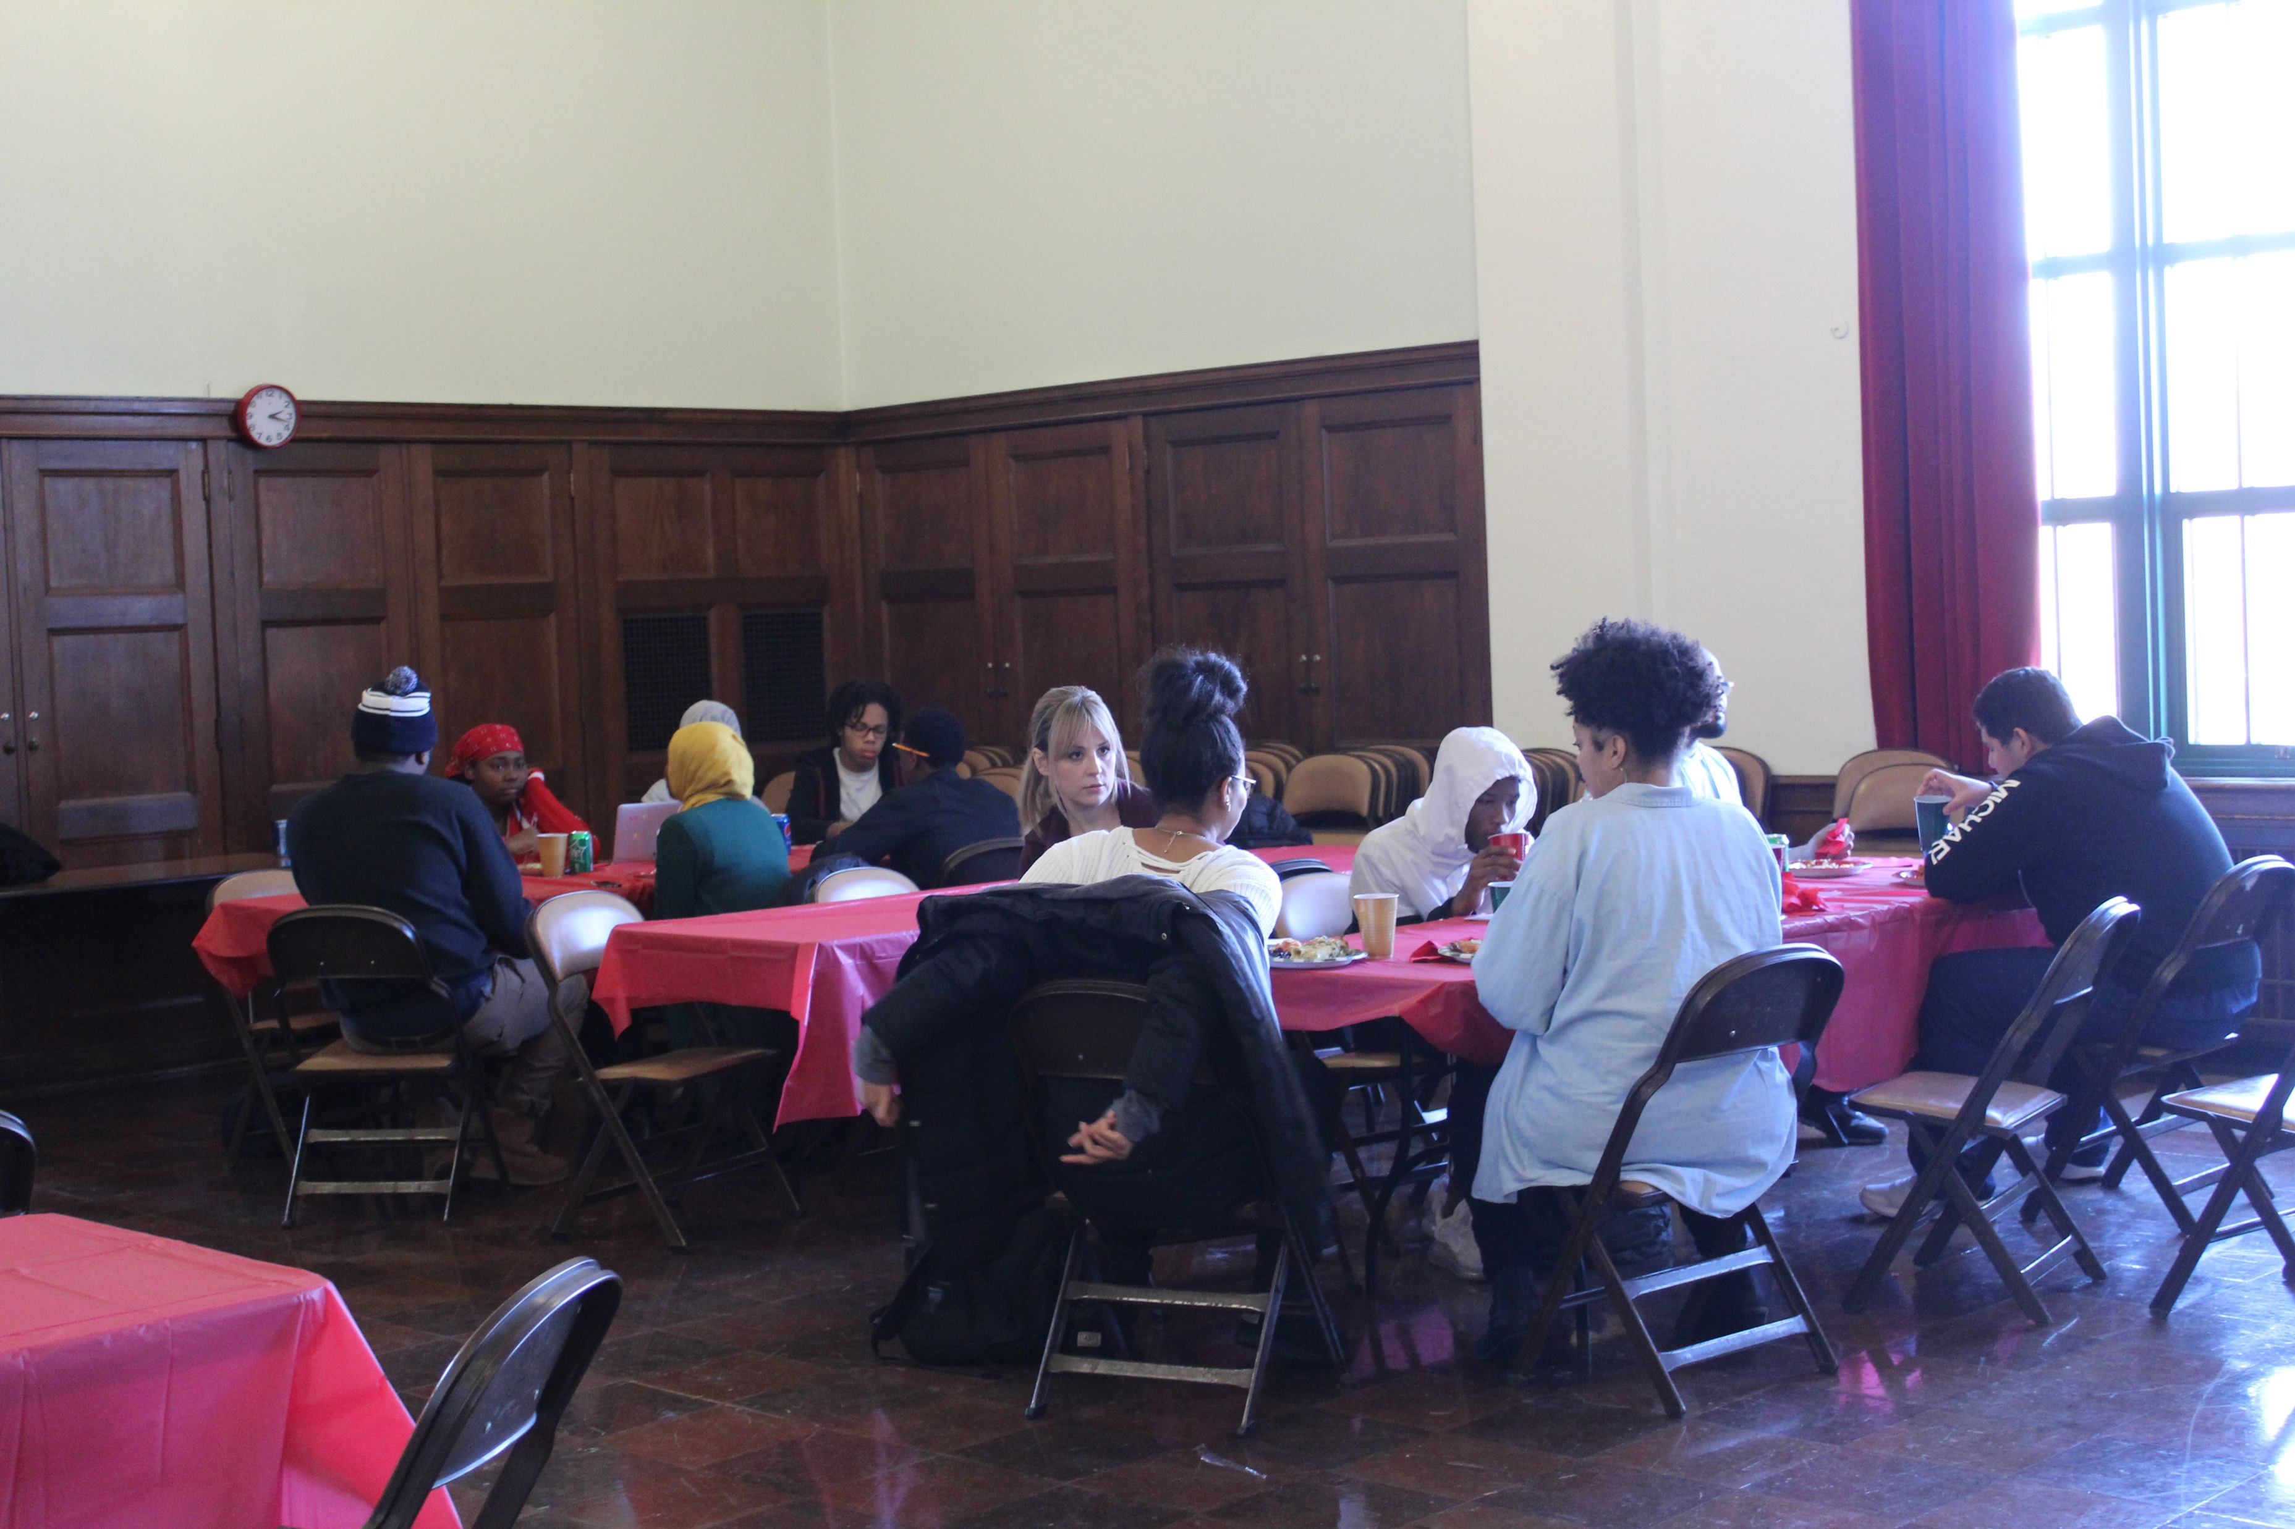
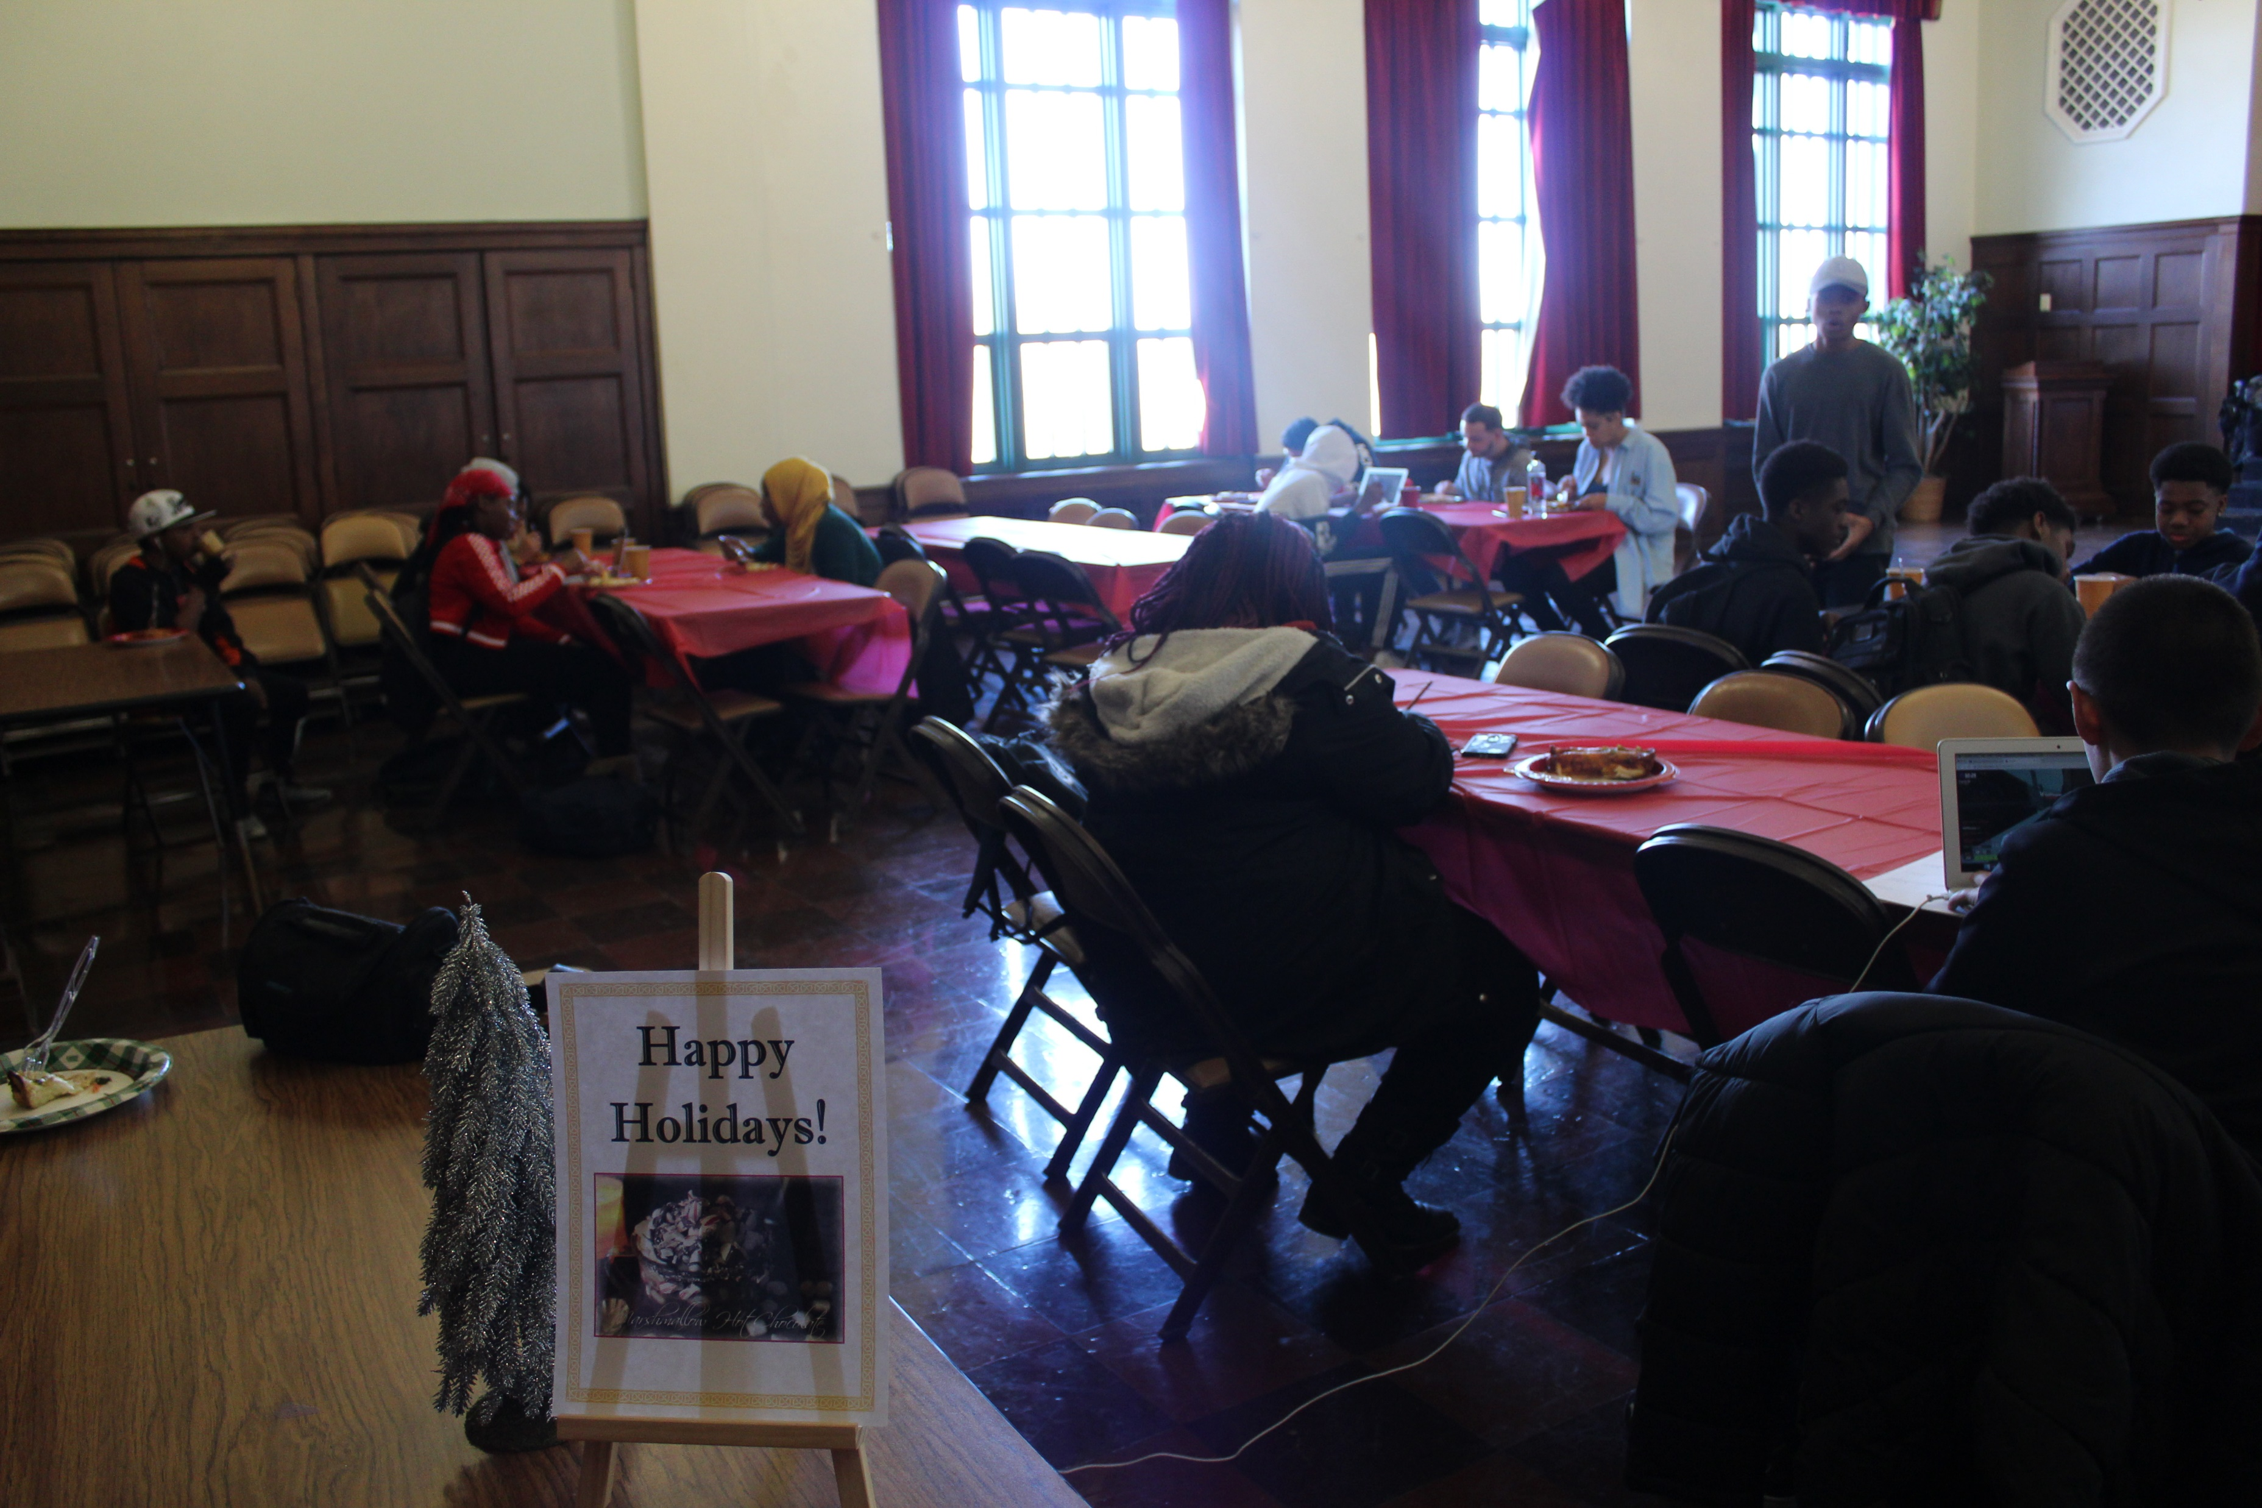
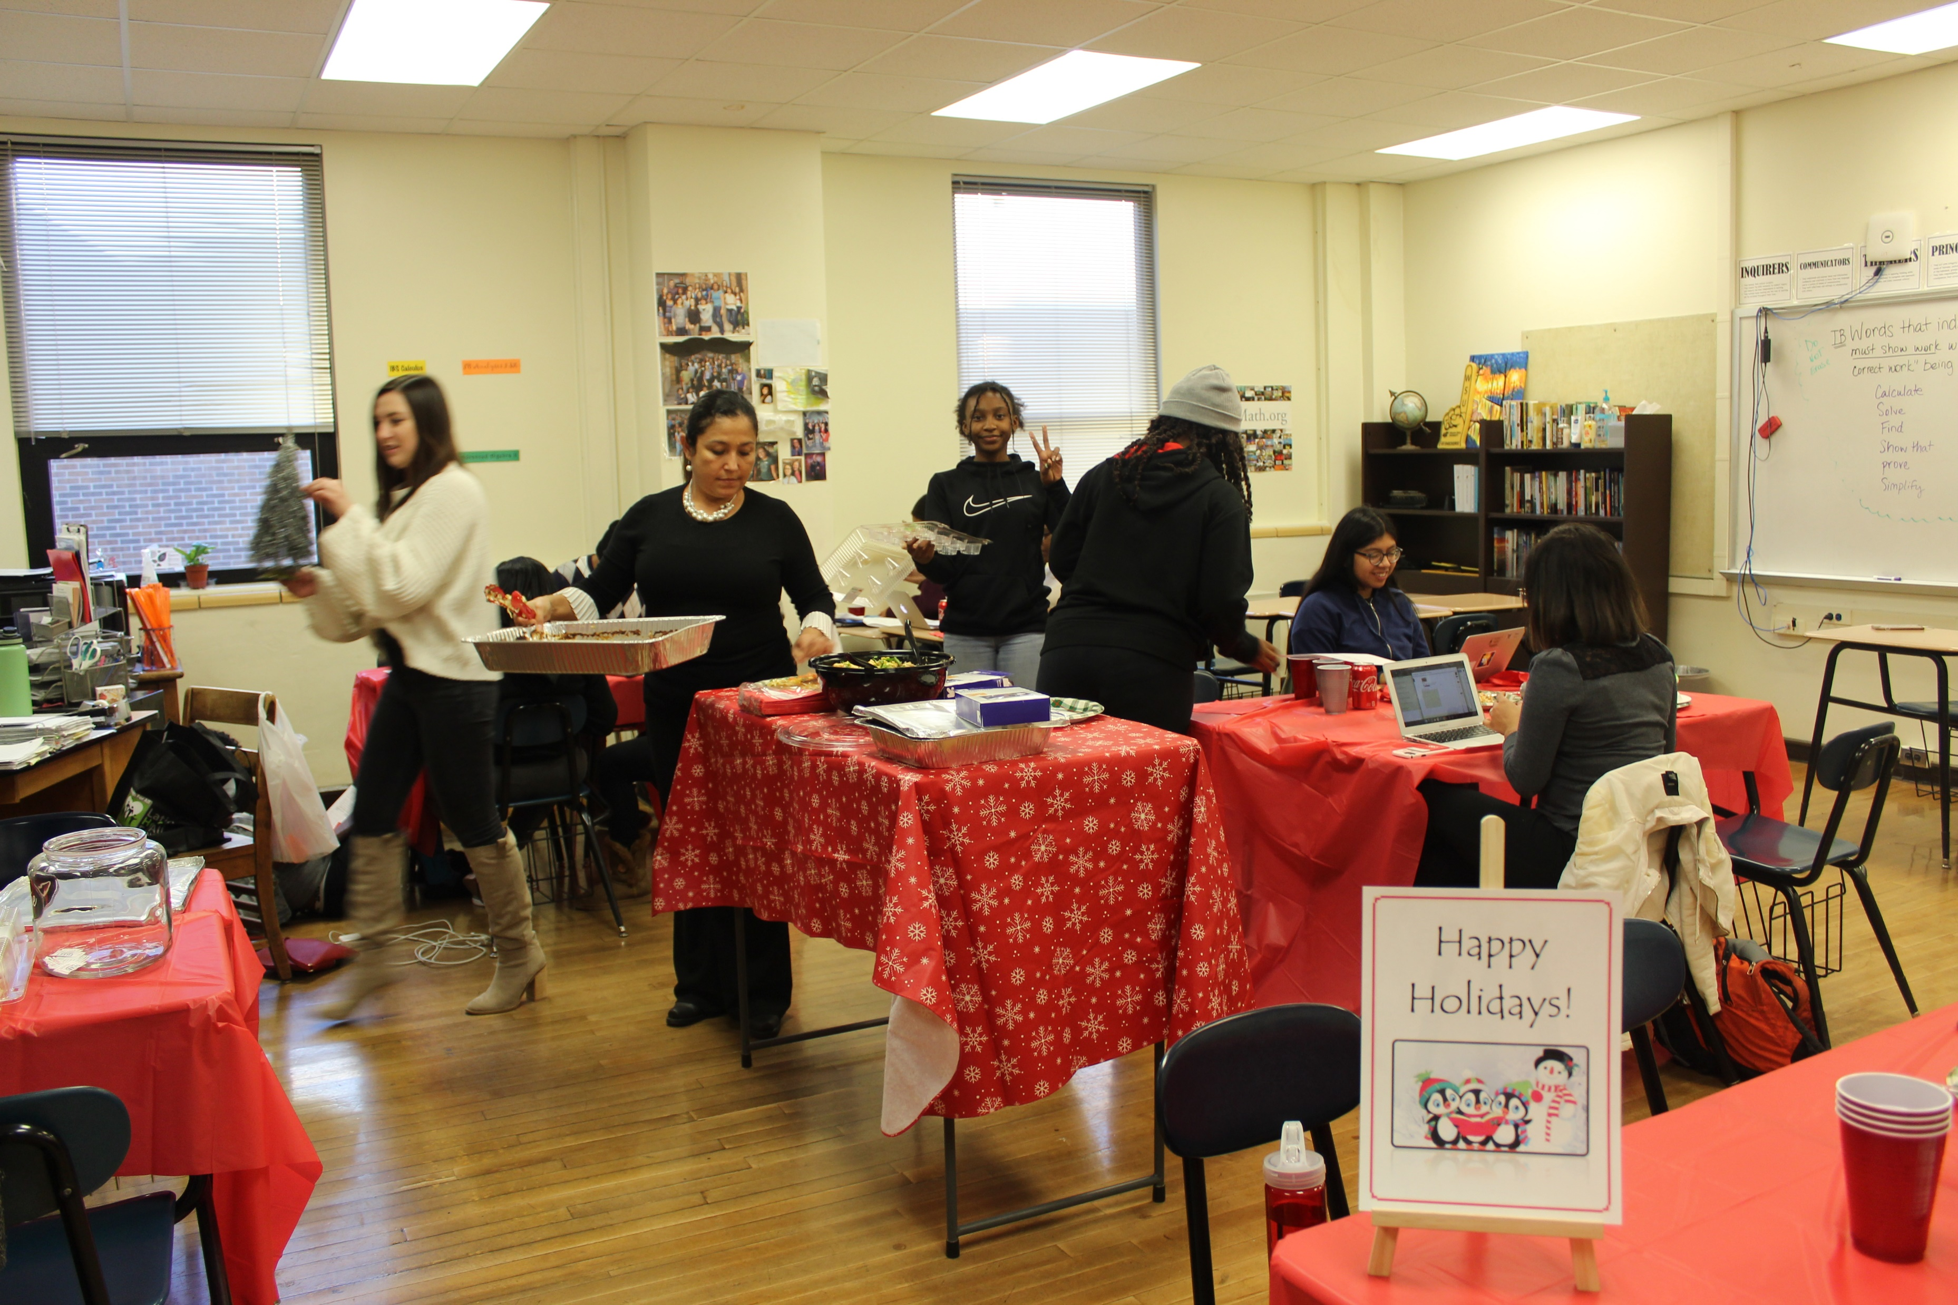
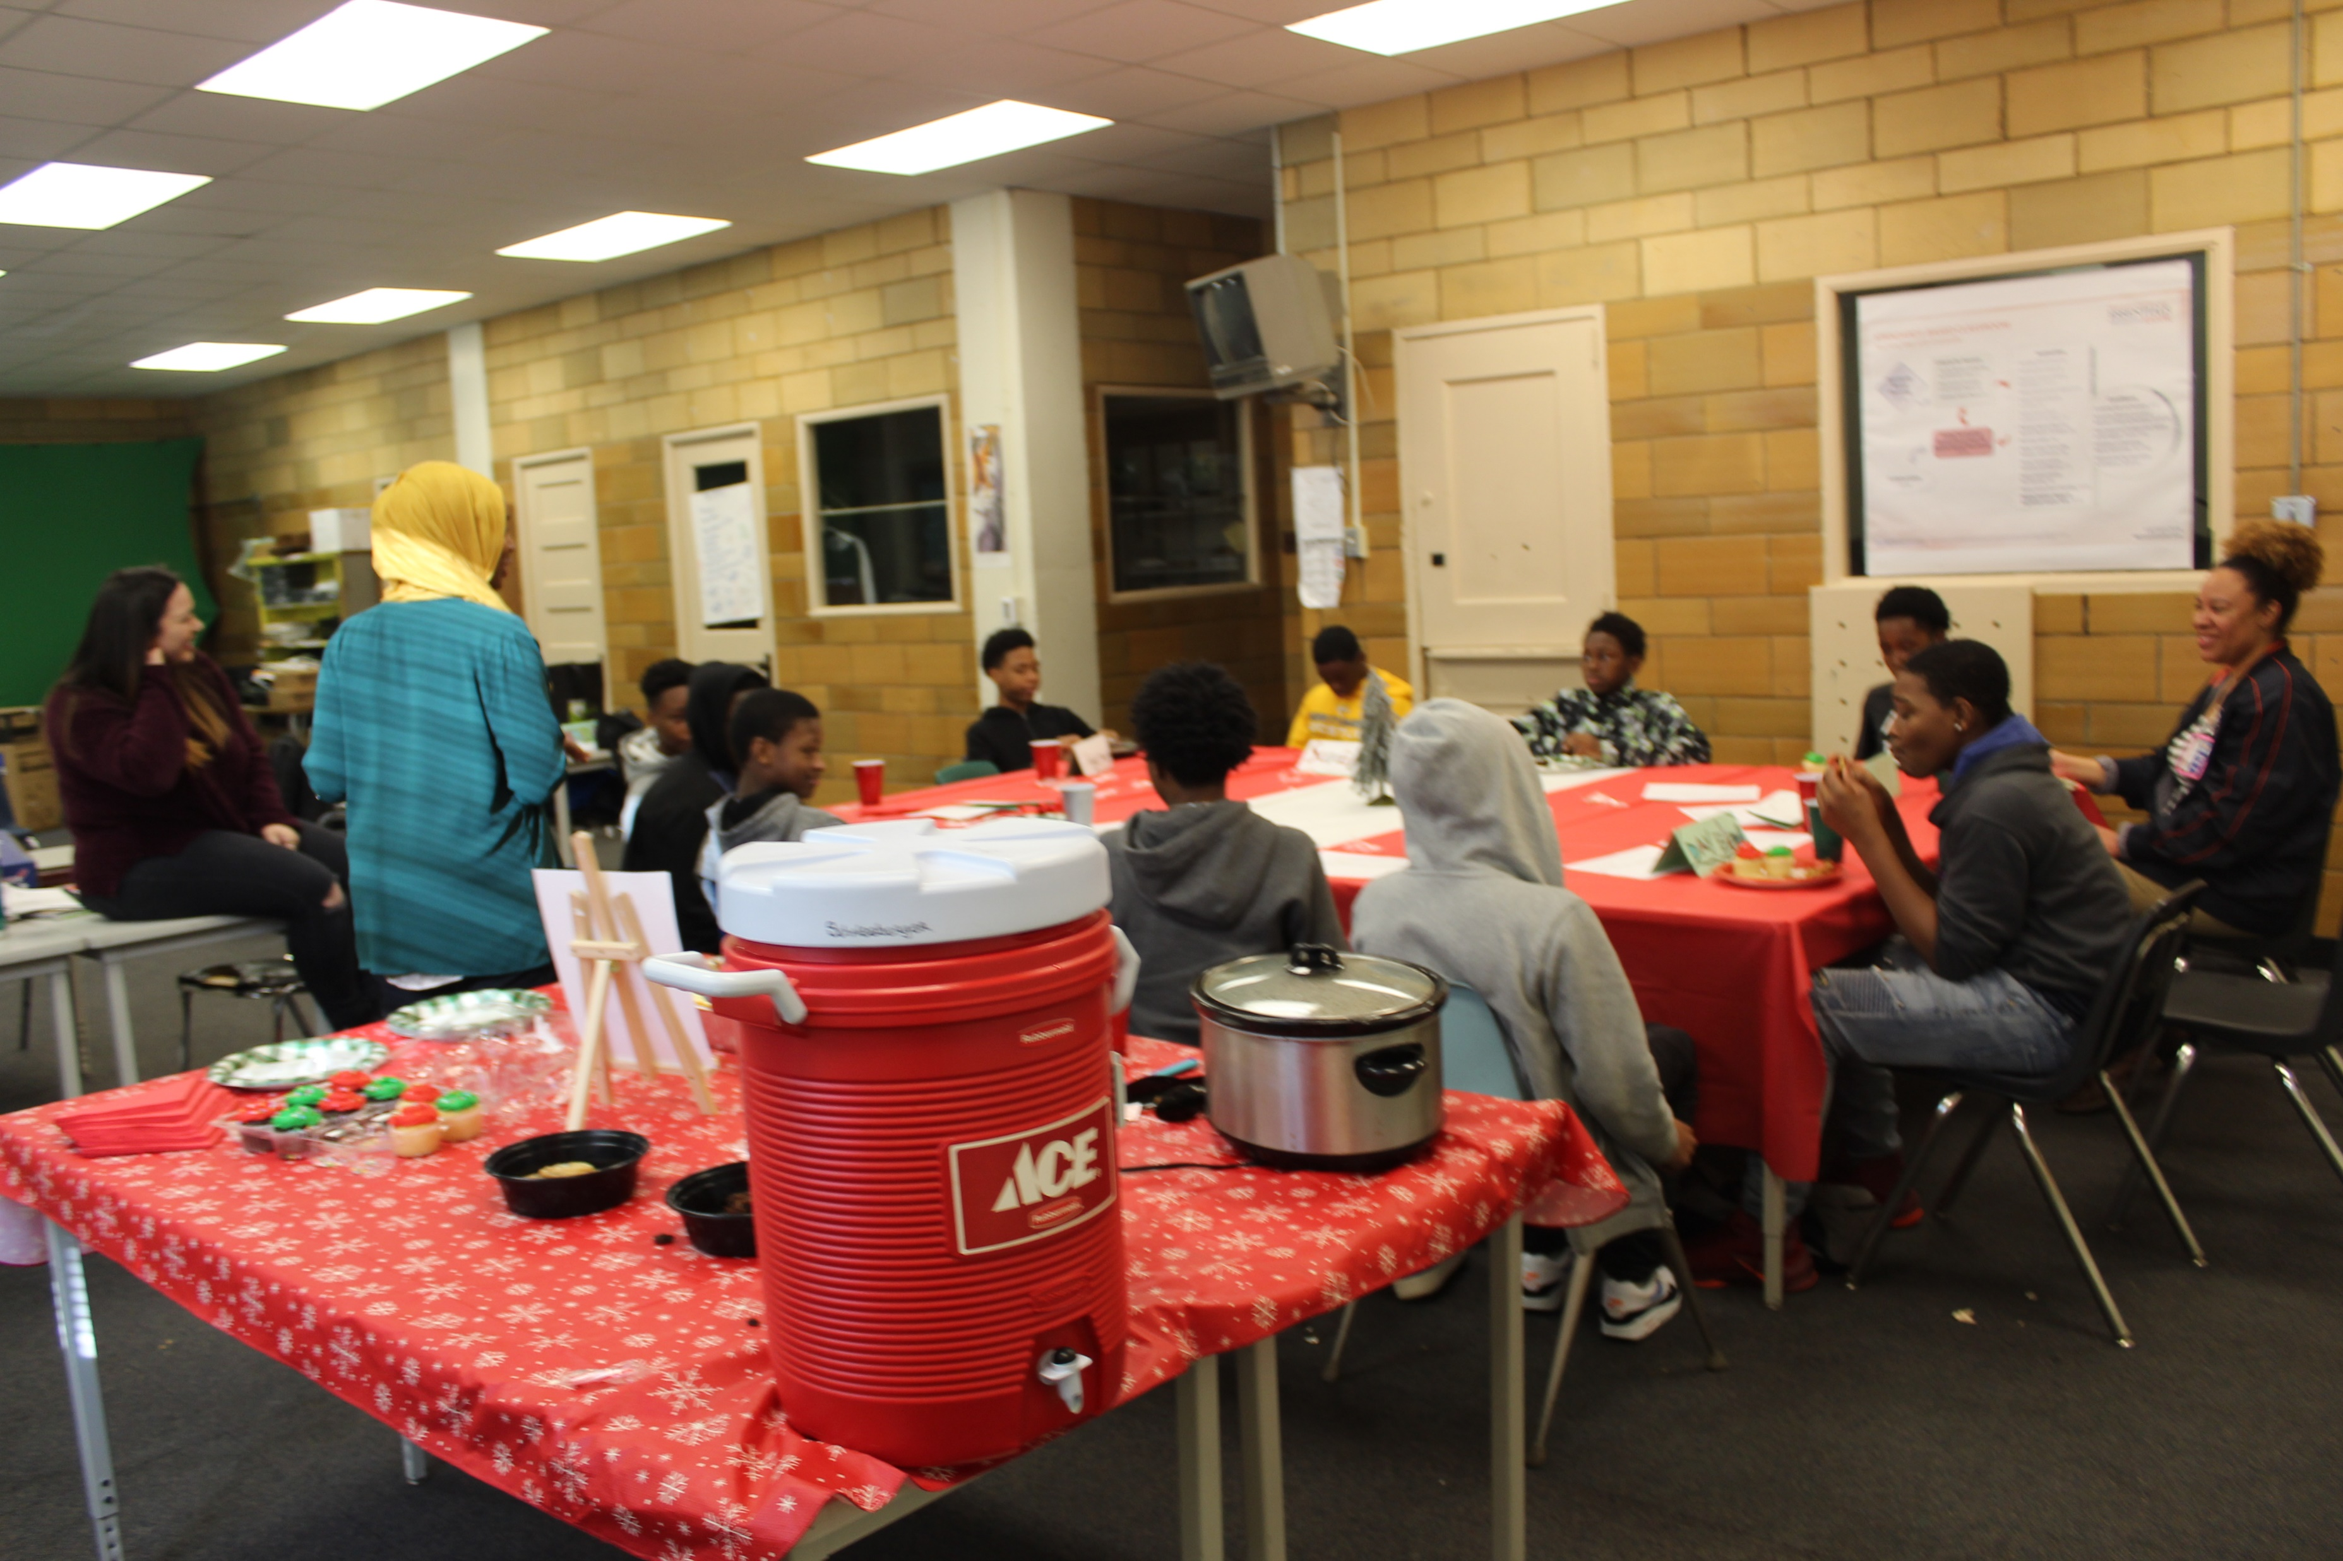
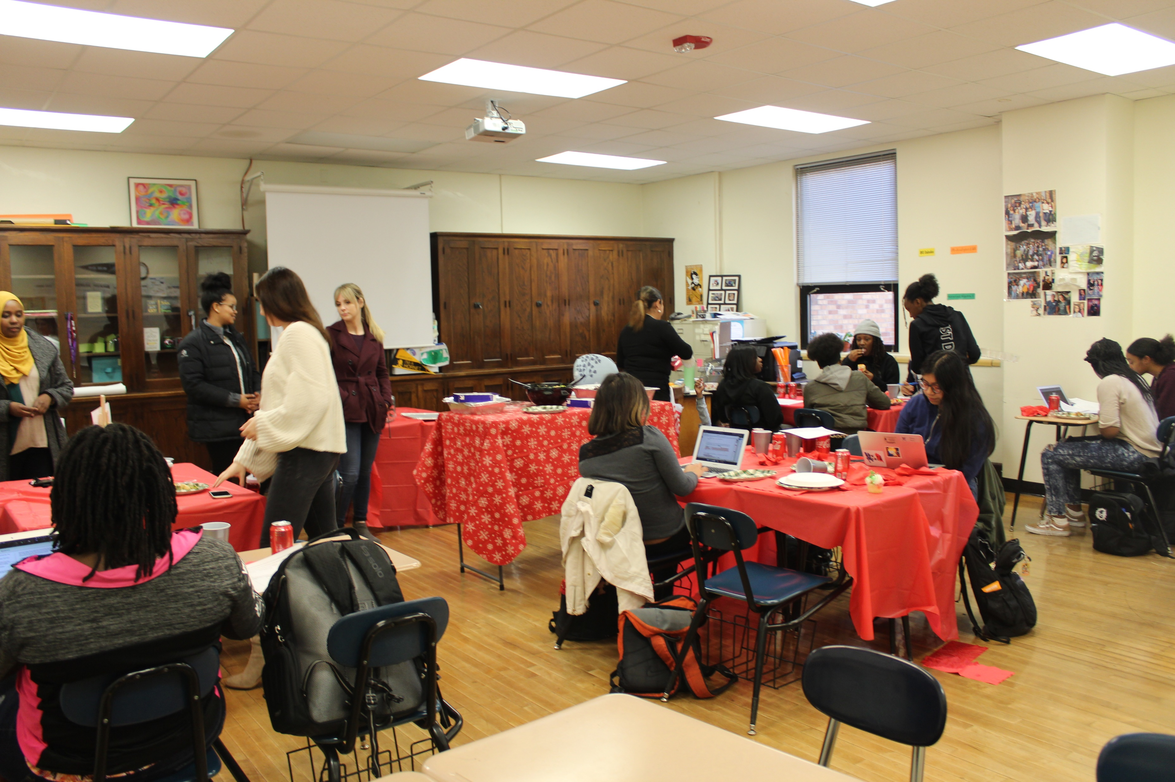

Slide 4
Systems Advisory Board Winter 2019

Slide 5
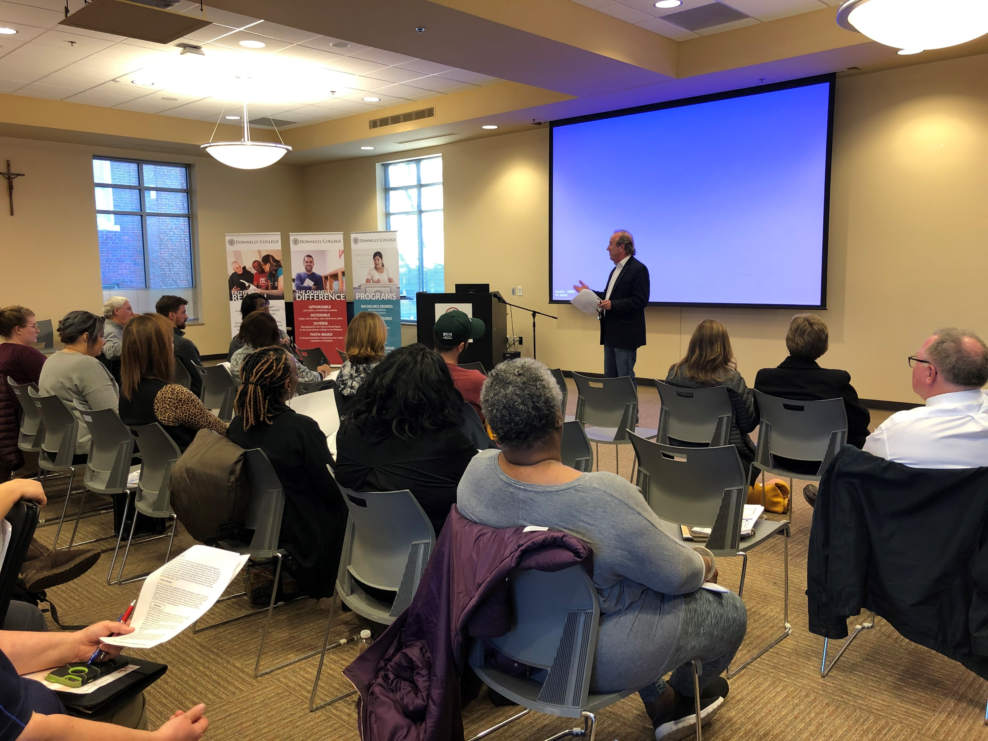
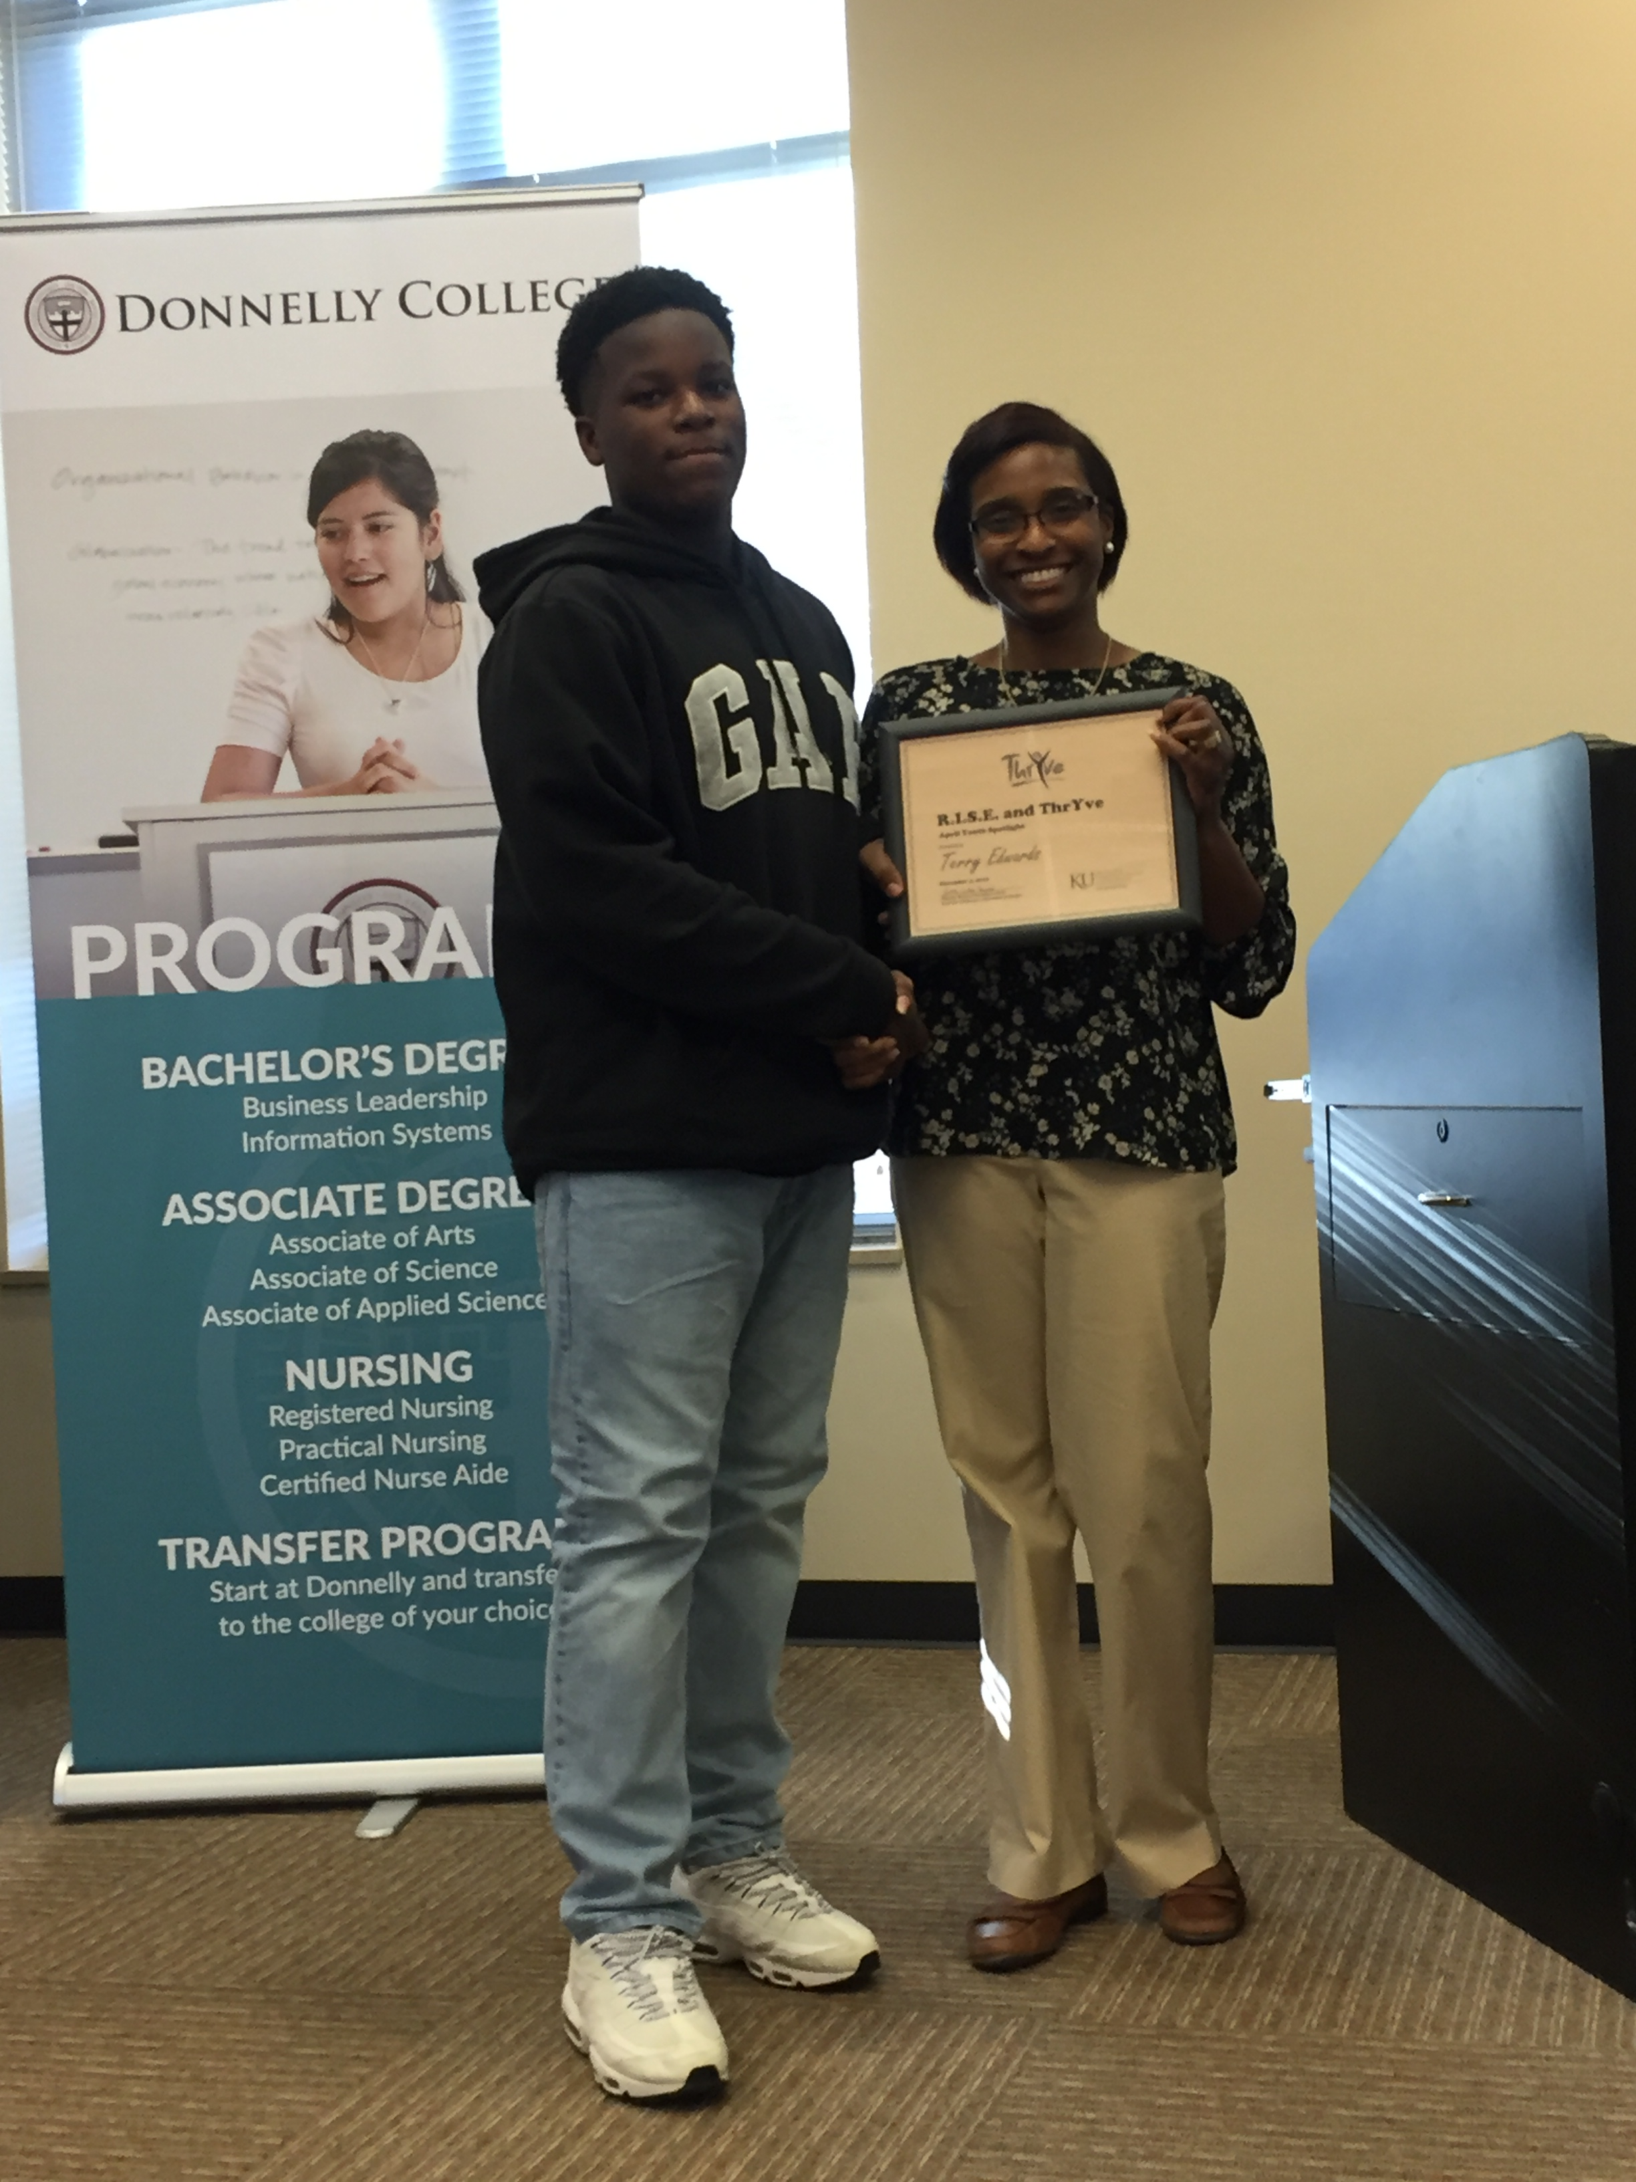

Slide 6
Farewell to the final Graduating Class at
Northwest Middle School

Slide 7
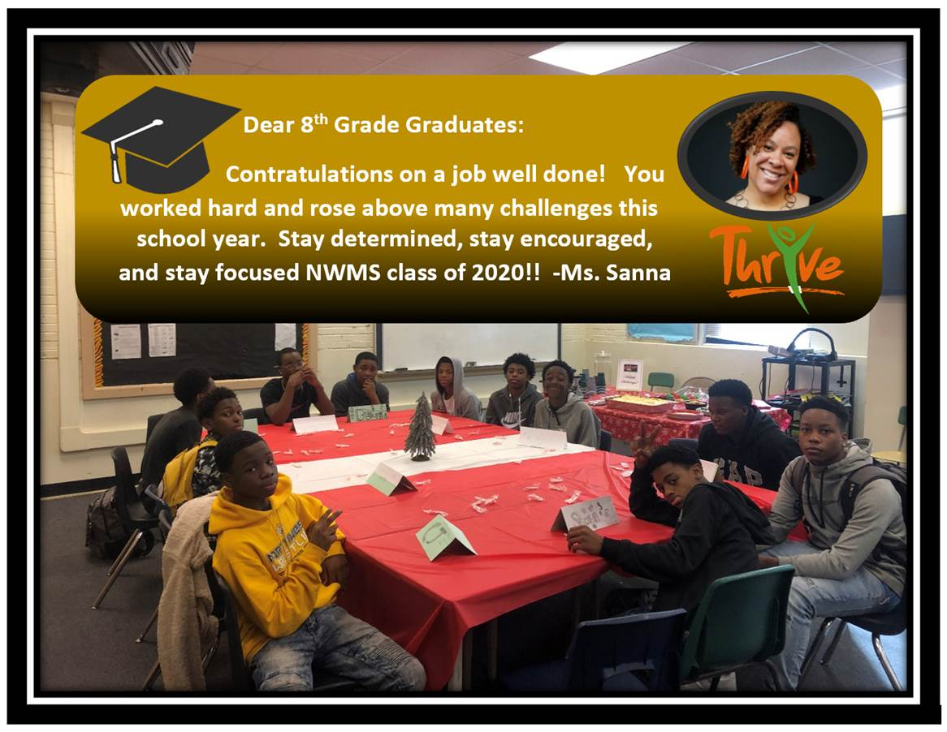

Slide 8
Students prepared chef inspired
dishes at home in partnership with
Young Women on the Move

Slide 10
Students received Heartland 180
curriculum and snack bags

Slide 11
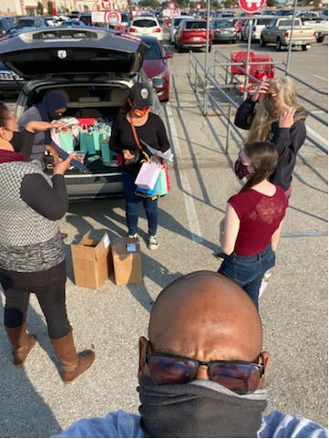

Slide 12
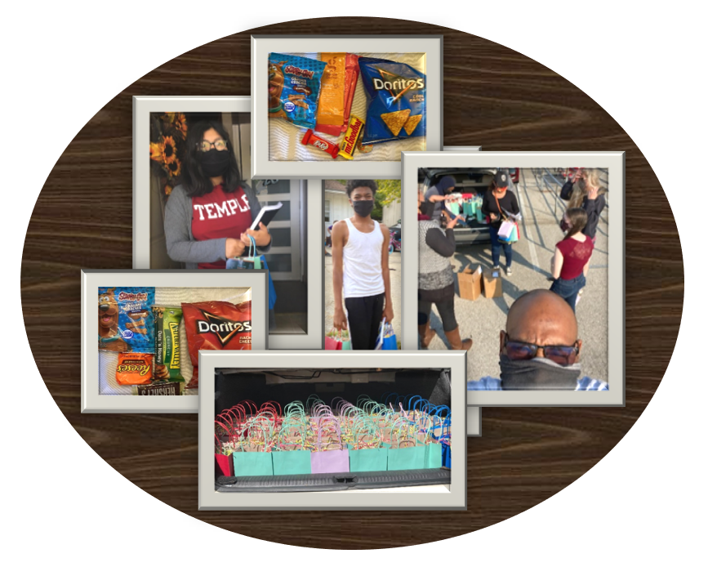

Slide 13
Students received backpacks with
School supplies from Made Men

Slide 14
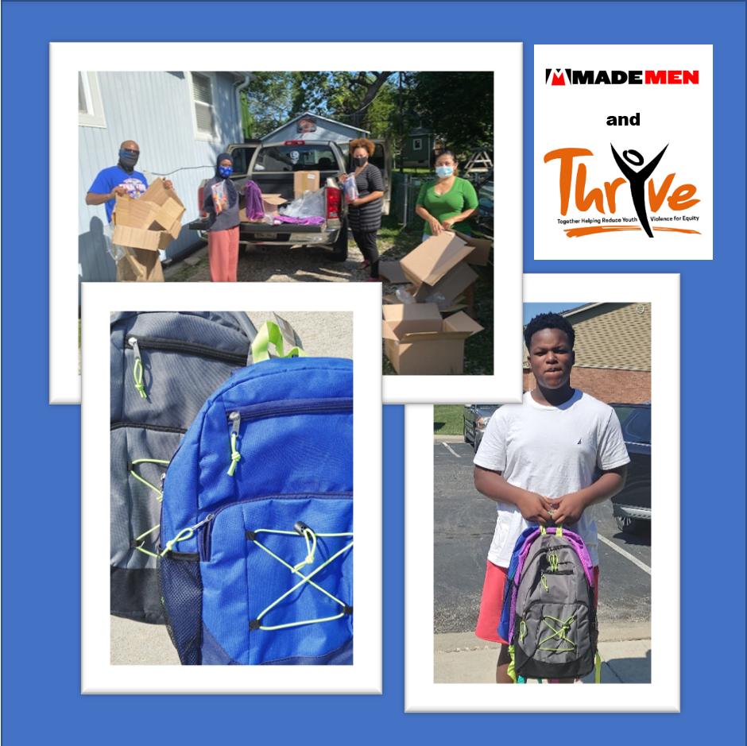

Slide 15
Virtual ThrYve Programming

Slide 16
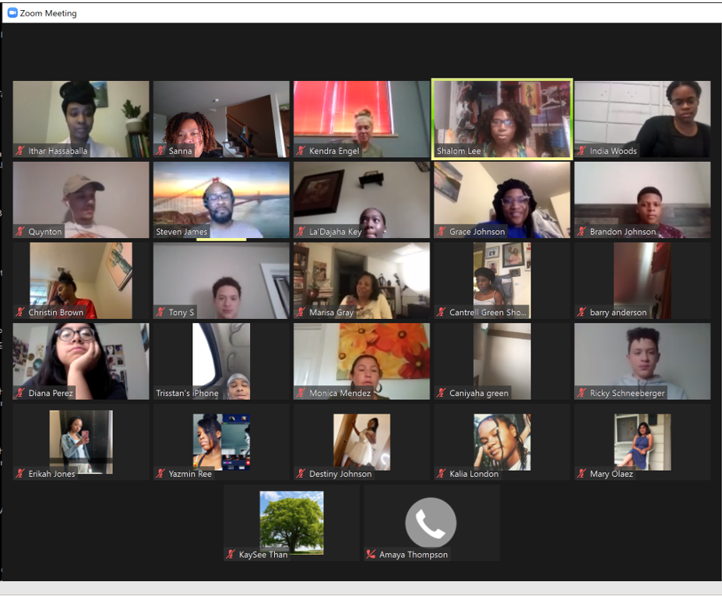

Slide 18
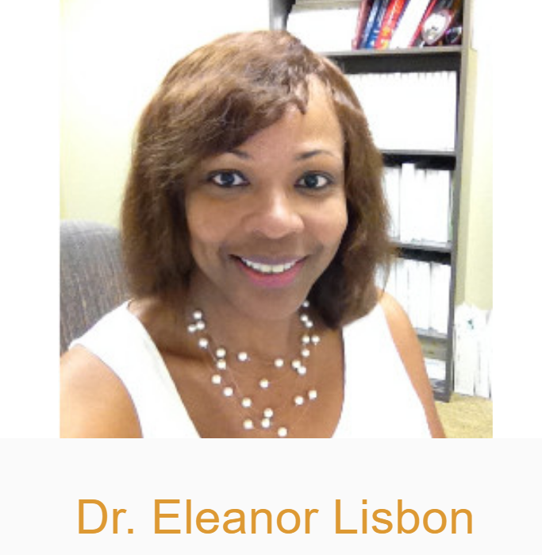
Facilitator

Slide 19
ThrYve Parent Group

Slide 20
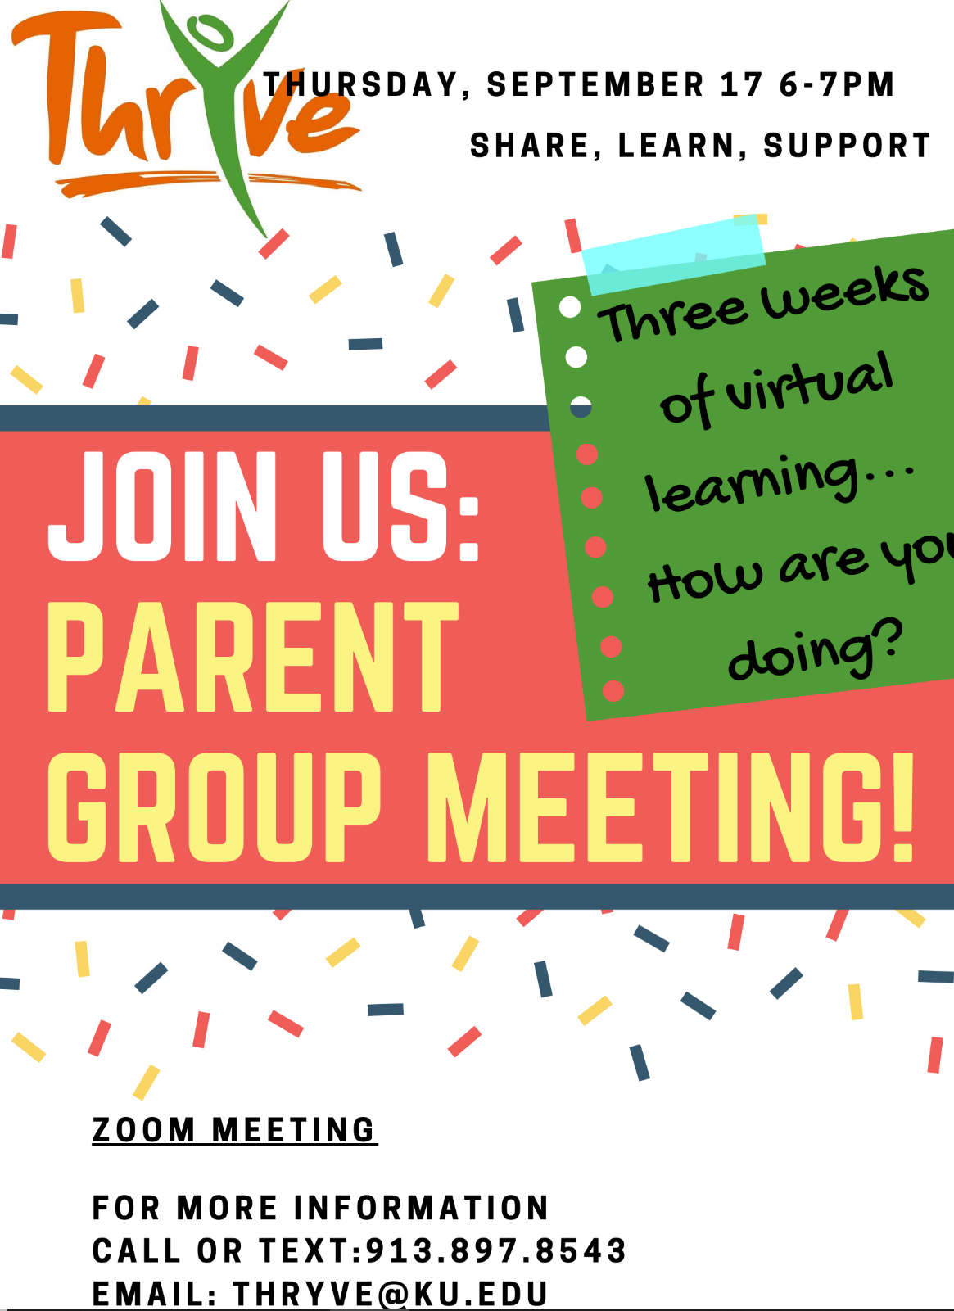
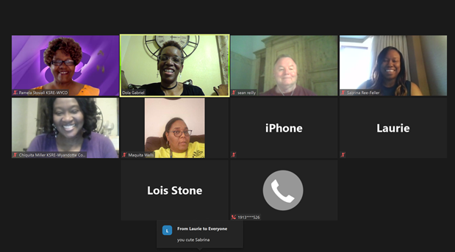

Slide 21
LEAD UP
(Leadership, Education,
Adolescent Development and
Unlimited Potential)

Slide 22
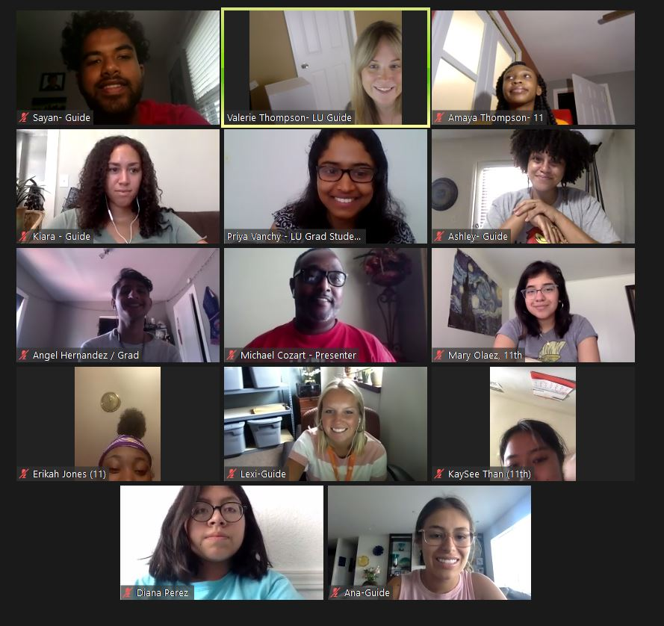
LEAD UP Summer Academy and Tutoring

Slide 23
Youth Helping Community Organizations

Slide 24
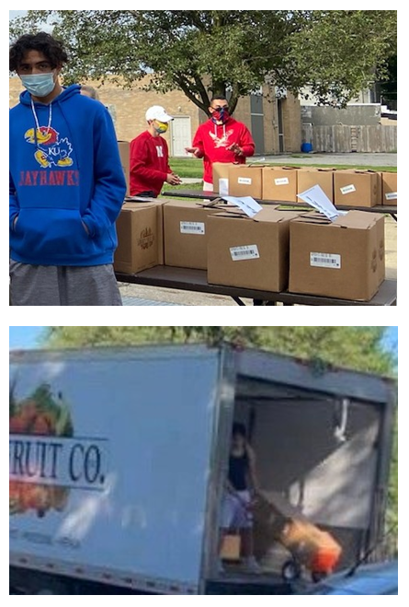

Slide 25
Summary of Summer 2020

